Slide 1
Introduction to Pandas

Slide 2
Table of Contents
Data Acquisition
Basic Insight of Dataset

Slide 3
Data Acquisition : Introduction
There are various formats for a dataset, .csv, .json, .xlsx etc. The dataset can be stored in different places: our local machine or sometimes online. In this section, we will learn how to load a dataset into our Jupyter Notebook. The pandas library is a useful tool that enables us to read various datasets into a DataFrame. Jupyter Notebook platforms have a built-in pandas library, so all we need to do is import pandas without installing.
Ex: import pandas as pd

Slide 4
Reading Data
We use pandas.read_csv() function to read the csv file. In the bracket, we put the file path along with a quotation mark. That way pandas will read the file into a DataFrame from that address. The file path can be either an URL or your local file address.
If the data does not include headers, we can add an argument header = None inside the read_csv() method so that pandas will not automatically set the first row as a header. We can also assign the dataset to any variable you create. In our case, the Titanic dataset already contains header. So, we won't use the argument for header.
Ex: import pandas as pd
path = “filepath/file.csv”
df = pd.read_csv(path)
If the file is online, we can provide the URL inside the double quote.

Slide 5
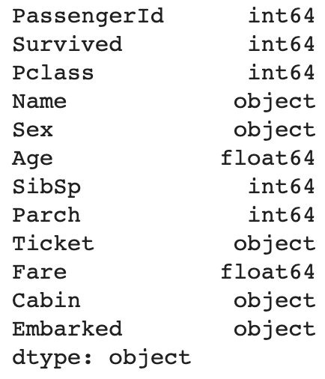
Basic Insights of Dataset : dtypes
After reading data into pandas DataFrame, it is time for us to explore the dataset. There are several ways to obtain essential insights of the data to help us better understand our dataset.
Data has a variety of types. The main types stored in a pandas DataFrame are object, float, int, bool and datetime64. In order to better learn about each attribute, it is always good for us to know the data type of each column. In pandas:
Ex: print(df.dtypes)
>>>
This returns a series with the data type of each column. it is clear to see that the data type of "PassengerID" is int64, "Cabin" is object, and "Fare" is float64, etc.

Slide 6
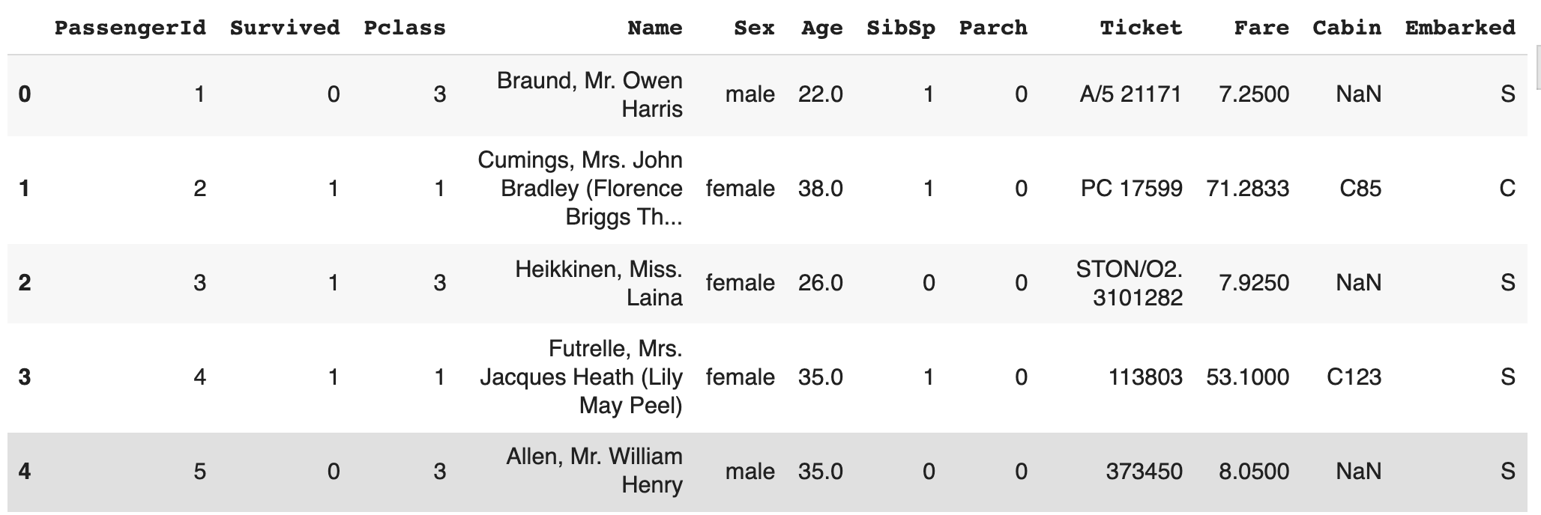
Showing Data : head()
After reading the dataset, we can use the dataframe.head(n) method to check the top n rows of the DataFrame where n is an integer. Contrary to dataframe.head(n), dataframe.tail(n) will show us the bottom n rows of the DataFrame. By default the value of n is 5.
Ex: print("The first 5 rows of the dataframe")
df.head()
>>>

Slide 7
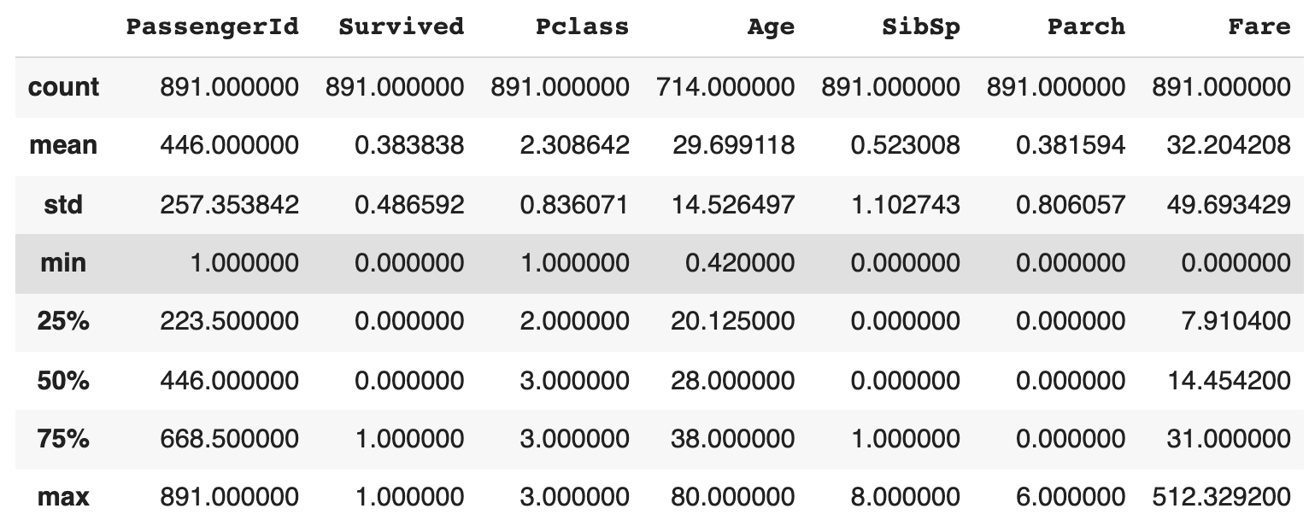
Basic Insights of Dataset : describe()
If we would like to get a statistical summary of each column like count, column mean value, column standard deviation, etc, we use the describe() method:
Ex: print(df.describe())
>>>
This method will provide various summary statistics, excluding NaN (Not a Number) values. This shows the statistical summary of all numeric-typed (int, float) columns. For example, the attribute "Fare" has 891 counts, the mean value of this column is 0, the standard deviation is 49.69.. and so on.

Slide 8
Basic Insights of Dataset : index, column
We can check the index and name of columns using the following functions:
Ex: print(df.index)
>>> RangeIndex(start=0, stop=891, step=1)
print(df.columns) >>> Index(['PassengerId', 'Survived', 'Pclass', 'Name', 'Sex', 'Age', 'SibSp',
'Parch', 'Ticket', 'Fare', 'Cabin', 'Embarked'], dtype='object')

Slide 9
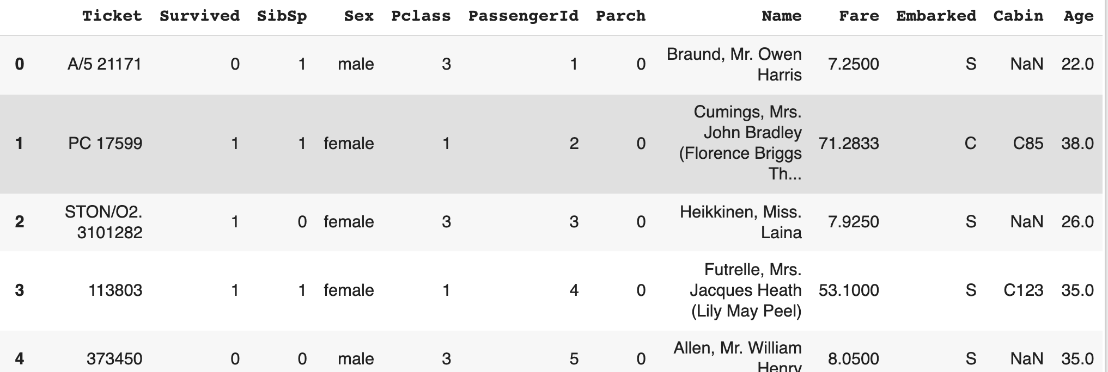
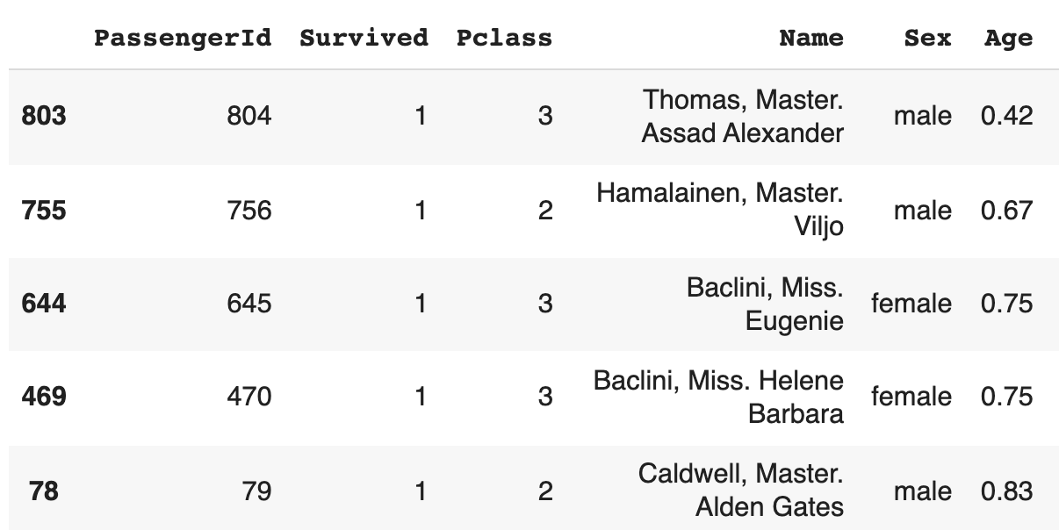
Basic Insights of Dataset : sort_index, sort_values
We can sort the dataframe by an axis, either 0 or 1
We can sort them too by a specific value of a column like the following example:
Ex: print(df.sort_index(axis=1, ascending=False))
>>>
Ex: print(df.sort_values(by='Age'))
>>>

Slide 10
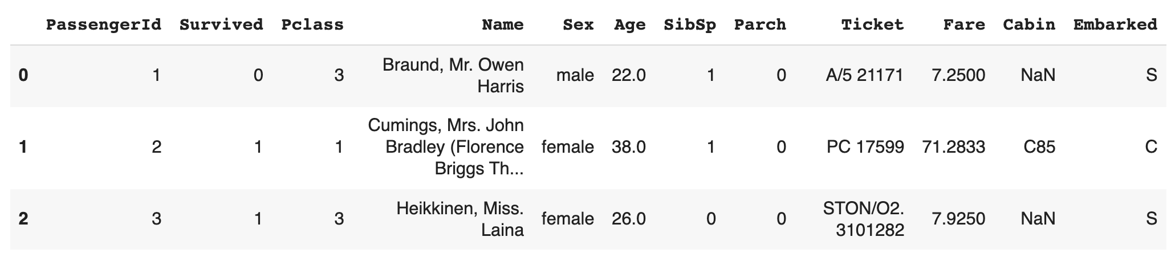
Basic Insights of Dataset : slice
Like Numpy Array we can do slice in pandas dataframe too :
Ex: print(df[0:3])
>>>

Slide 11
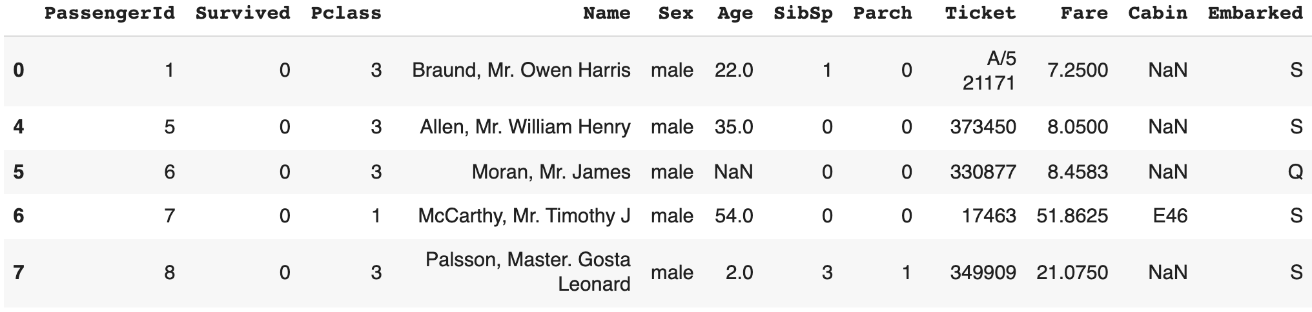
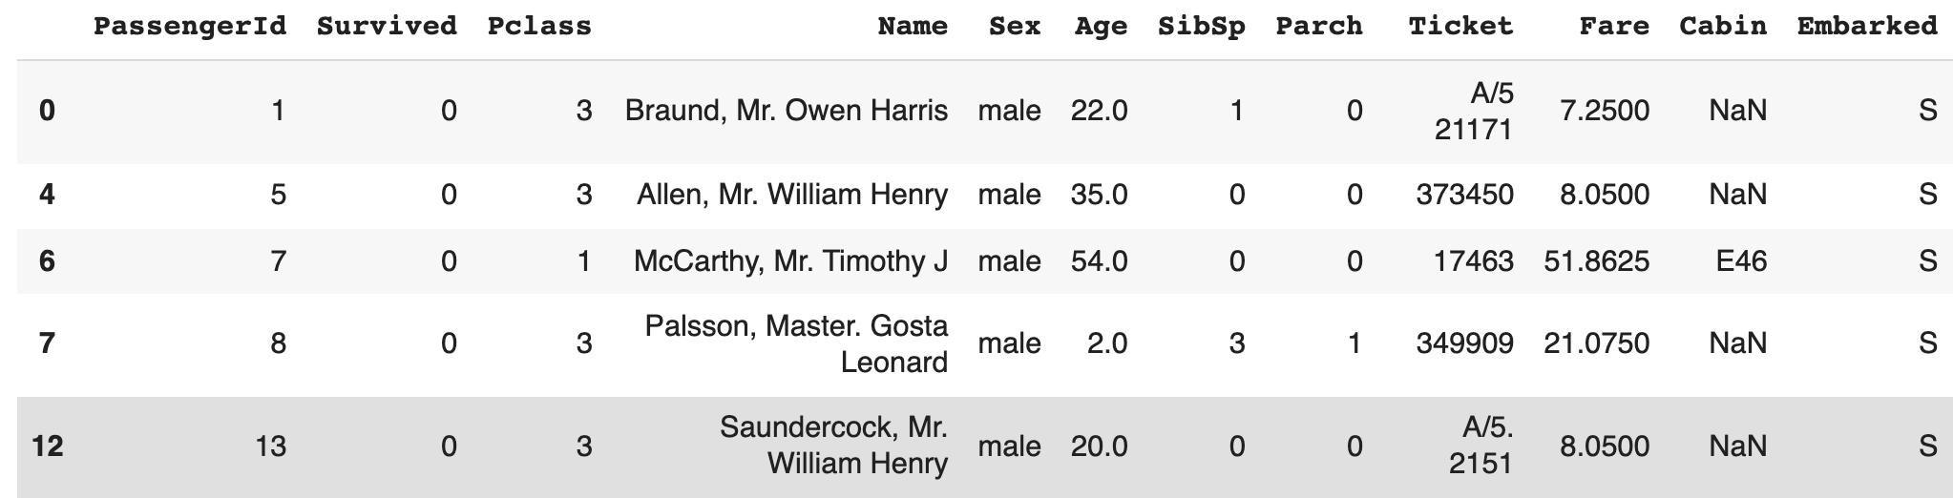
Basic Insights of Dataset : selection by label
We can use loc to filter data:
Similarly, we can add more filter options:
Ex: print(df.loc[df['Sex']=='male'])
>>>
Here, we are filtering data of all the male passangers by using the label of column named "Sex" and its value "male"
Ex: print(df.loc[(df['Sex']=='male') & (df['Embarked']=='S')])
>>>

Slide 12
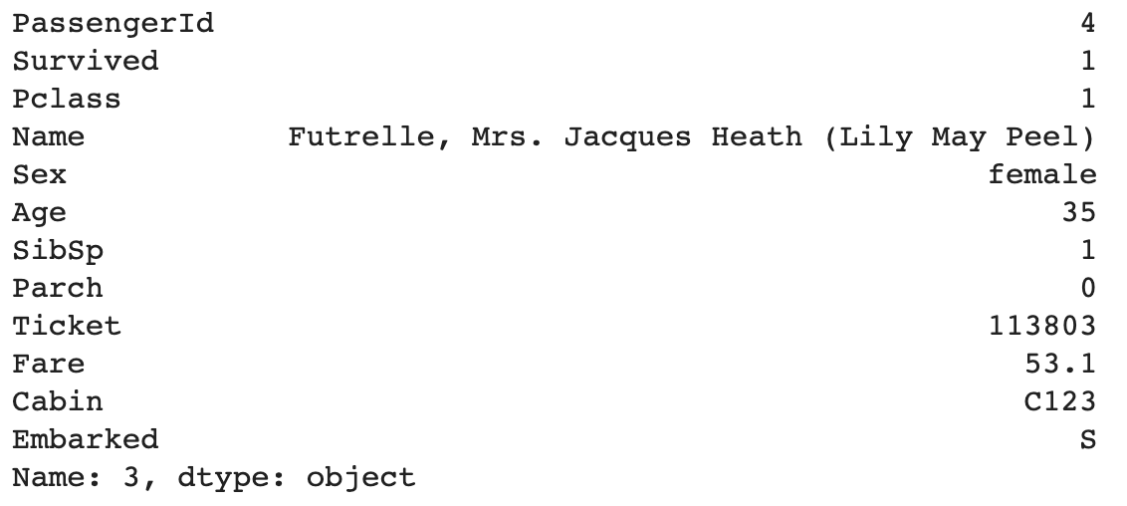
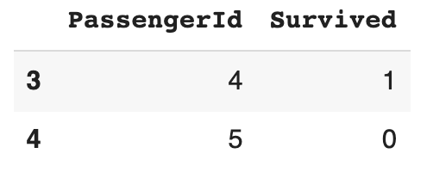
Basic Insights of Dataset : selection by position
We can select data via the position of the passed integers instead of label:
Similarly, we can fix row and column limit:
Ex: print(df.iloc[3])
>>>
Ex: print(df.iloc[3:5, 0:2])
>>>

Slide 13
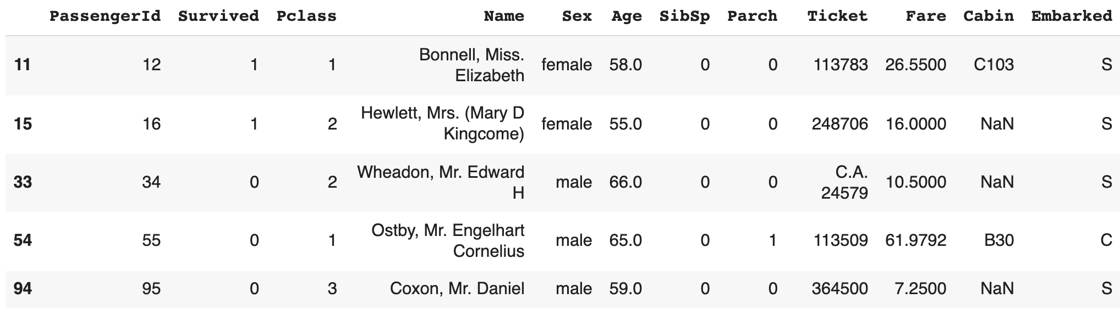
Basic Insights of Dataset : Boolean Indexing
We can also do boolean indexing that is to select column's value to select data:
Ex: print(df[df["Age"] > 54])
>>>
Here, we are only selecting the data of passengers who are above 54 by age

Slide 14
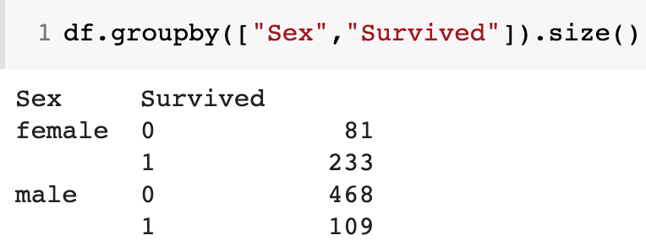
Basic Insights of Dataset : groupby()
groupby() allows to pass functions to apply to each column which produces an aggregated result with a hierarchical index:
Ex: print(df.groupby(["Sex","Survived"]).size())
>>>
This result shows that, 81 female and 468 male passengers could not survive during the sinking of Titanic. On the other hand, 233 female and 109 male passengers survived.

Slide 15
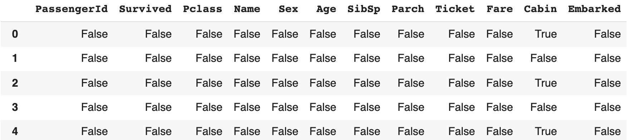
Missing Values : dropna(), fillna(), isna()
dropna() can remove the missing values. First, we just make a copy and then drop the values because we don't want to modify our original data too much.
If we don't want to drop, we can fill the missing values. For example, in the following example, we are filling the missing values of "Age" column with median Age:
To get the boolean mask where values are nan, we can use isna() :
Ex: df1 = df.copy()
df1.dropna(how="any")
Ex: df['Age'] = df['Age'].fillna(df['Age'].median())
Ex: pd.isna(df1)
>>>

